Slide 1
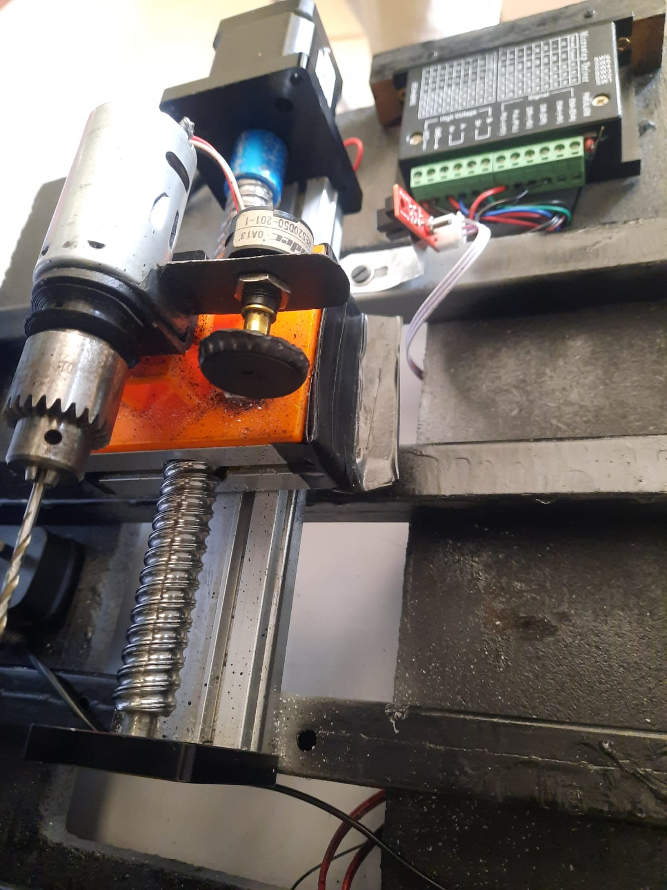
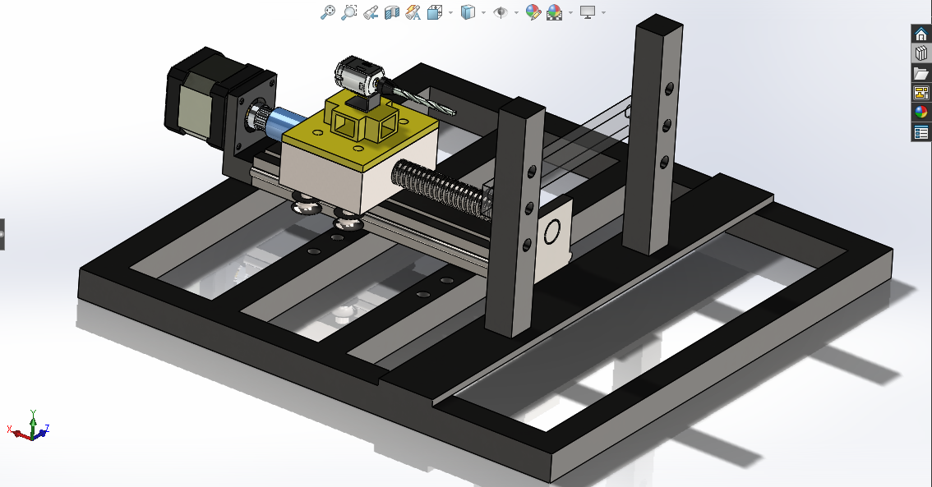
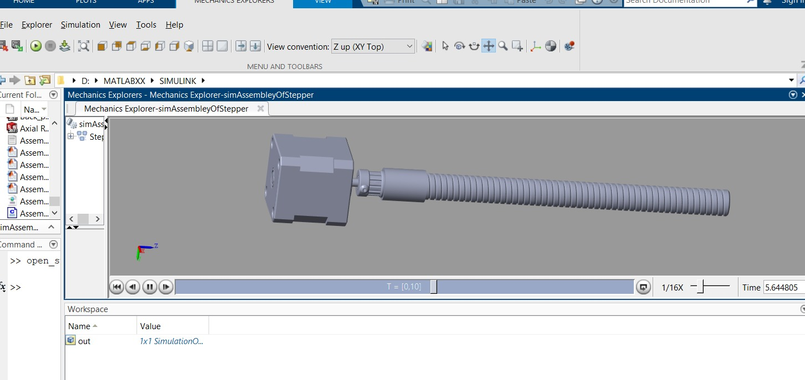
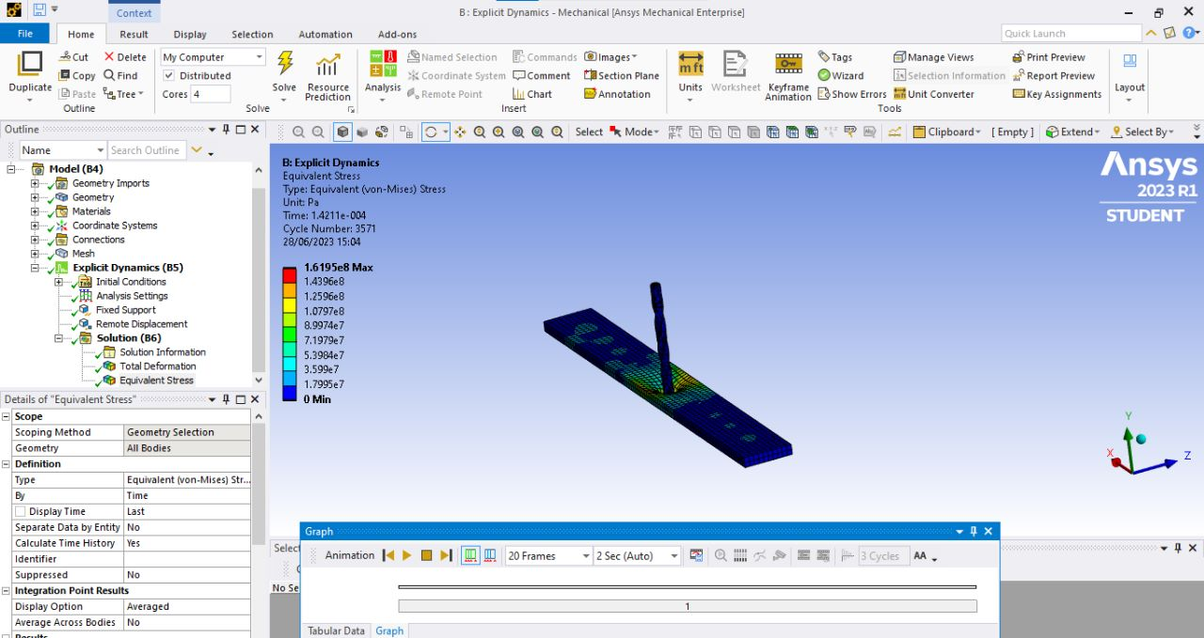
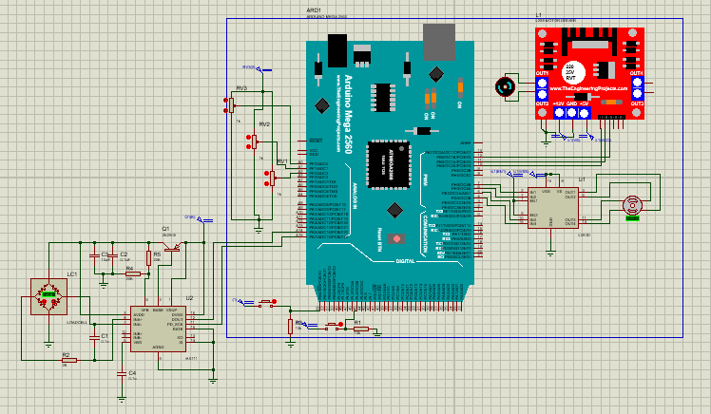
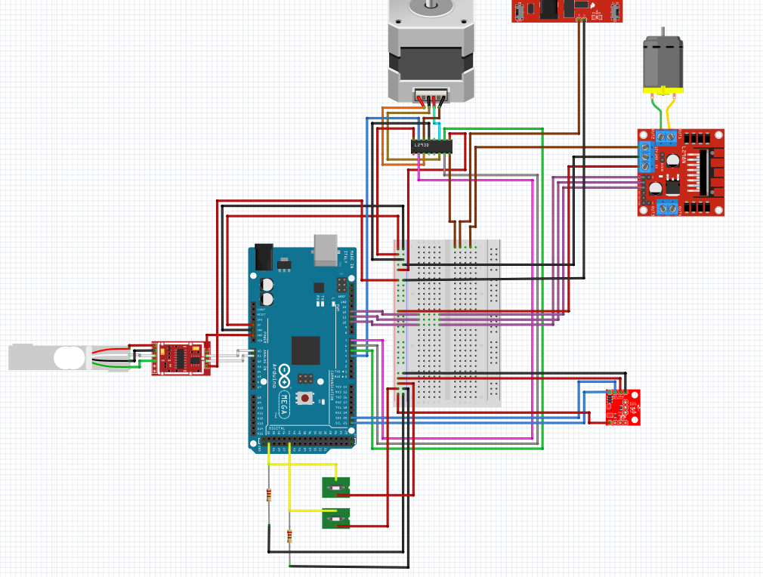
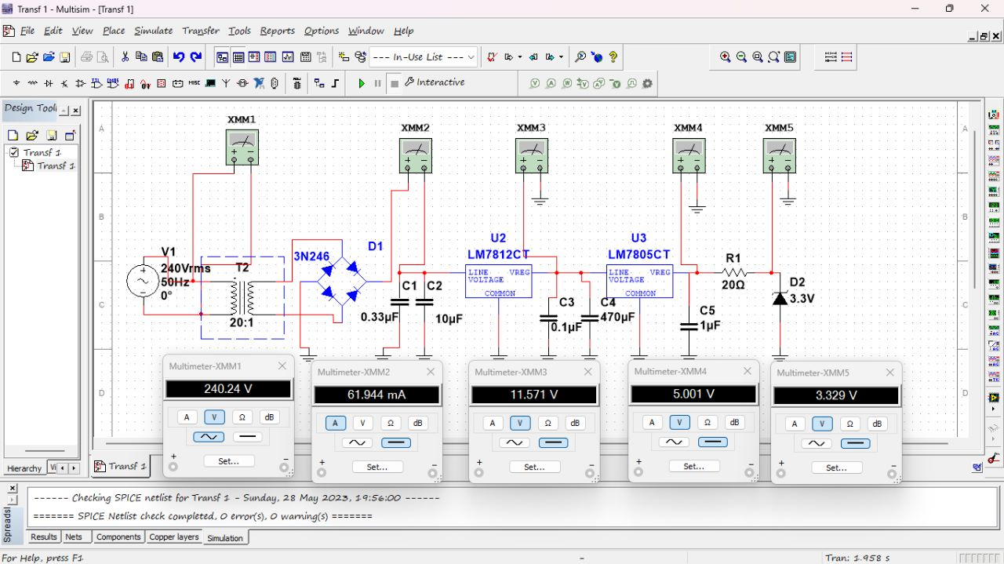
GROUP MEMBERS
Mary Mbaire Mbugua
Renox Kipkoech
Morris Lesinko
4. Philip Katiechi
5. Allan Kyalo
6. Stephen Gitau
STUDY AND DEVELOPMENT OF
AN AUTOMATED
1-AXIS DRILL
29TH June, 2023
Supervisor: Dr. Titus Mulembo
ABSTRACT
High quality drilled holes are required in a lot of industrial and medical applications. It is imperative to design a low cost and precise drilling machine that can be used and which monitors vibrations resulting and forces applied to the workpiece during the drilling operation. This project focuses on the development of a one-axis drill system utilizing a polymer workpiece for improving bone drilling operations in medical applications. System monitoring is essential to determine the best parameters that can be used in system control for vibration mitigation while using analytical and computational resources to analyze behavior of PMMA under drilling operation while ensuring reduced chatter or risk if drill bit breakage and ensuring efficient material removal.
MAIN OBJECTIVE
Development of a precise automated one axis drill.
Specific Objectives
To design and simulate 3D model of the physical system
To develop project circuits and firmware to run sensors, actuators and peripherals.
To carry out experiments and analysis to determine parameters for vibration mitigation
EXPECTED OUTCOMES
To have an efficient firmware program for the working of sensors, actuators and peripherals for precise drilling operation
To establish optimal drilling parameters from experimental and computational analysis.
To visualize forces and vibration on the PMMA with respect to drill and feed speeds
To mitigate vibrations, chatter and reduced risk of drill bit breakage and ensure efficient material removal during drilling.
METHODOLOGY
1. Assessment of existing physical model
2. Development of program flowchart
3. CAD Design in Solidworks
3. Importing & simulating working system in Matlab Simscape
Determination of drilling control parameters
Upload the program to the microcontroller
Run the experiment
Results and Data Collection
Evaluation and analysis
4. Finite element analysis in Ansys
5. Programming and circuit simulation in Proteus, Multism, Fritzing
ACHIEVEMENTS
Mechanical design of the project in Solidworks and simulation of the working motors in Matlab
Circuit design in Proteus and simulations using Multism and Fritzing
Development of working firmware program to read accurate real time sensor data and control dc and stepper motor.

